Slide 1

SECTION B
IDA2-PROJECT

Slide 2
Introduction to the dataset
The dataset includes features like Patient ID, Age, Sex, Blood Pressure, Heart Rate, Cholesterol Levels, Diabetes Presence, Family History, Smoking Habits, and Obesity that are connected to the health of the patients.
Along with lifestyle characteristics, it also covers sleep hours per day, days per week of physical activity, and hours spent being sedentary each day.
The dataset also includes geographic information like country, continent, and hemisphere, as well as socioeconomic characteristics like income. The variable of interest is "Heart Attack Risk," indicating a potential emphasis on evaluating the risk of heart attacks through a range of lifestyle and health-related factors.

Slide 3
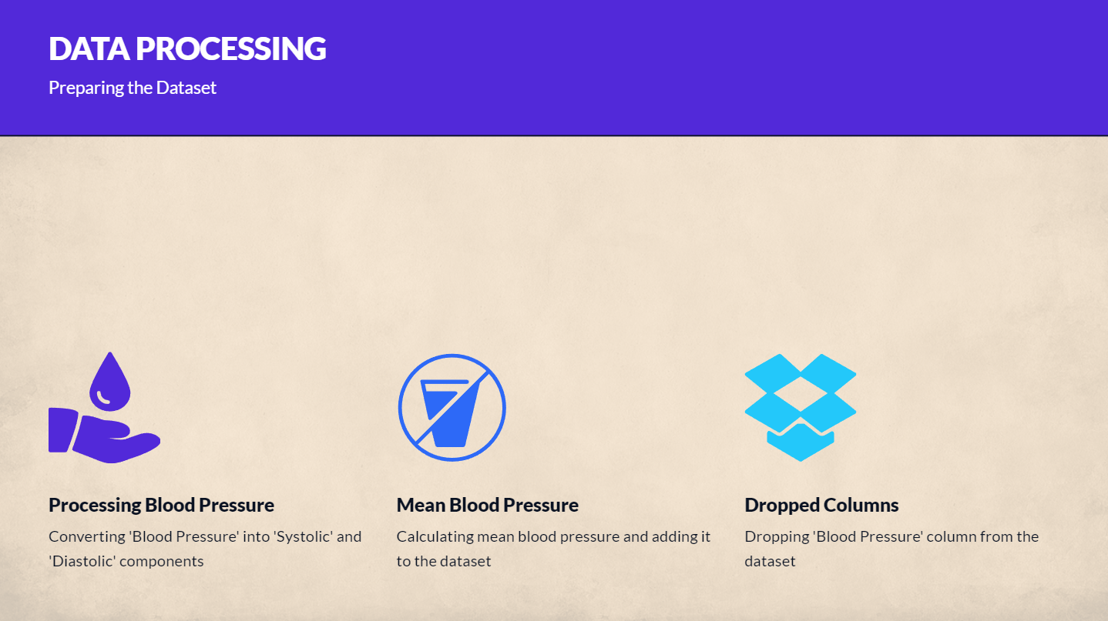

Slide 4
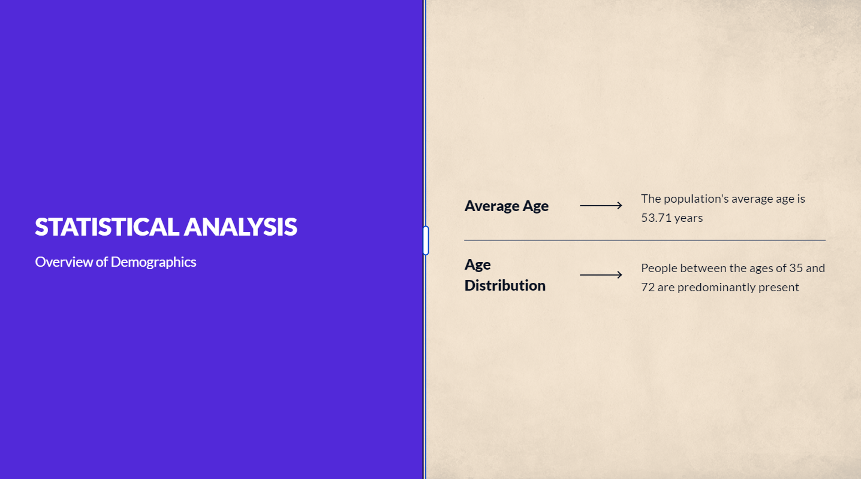

Slide 5
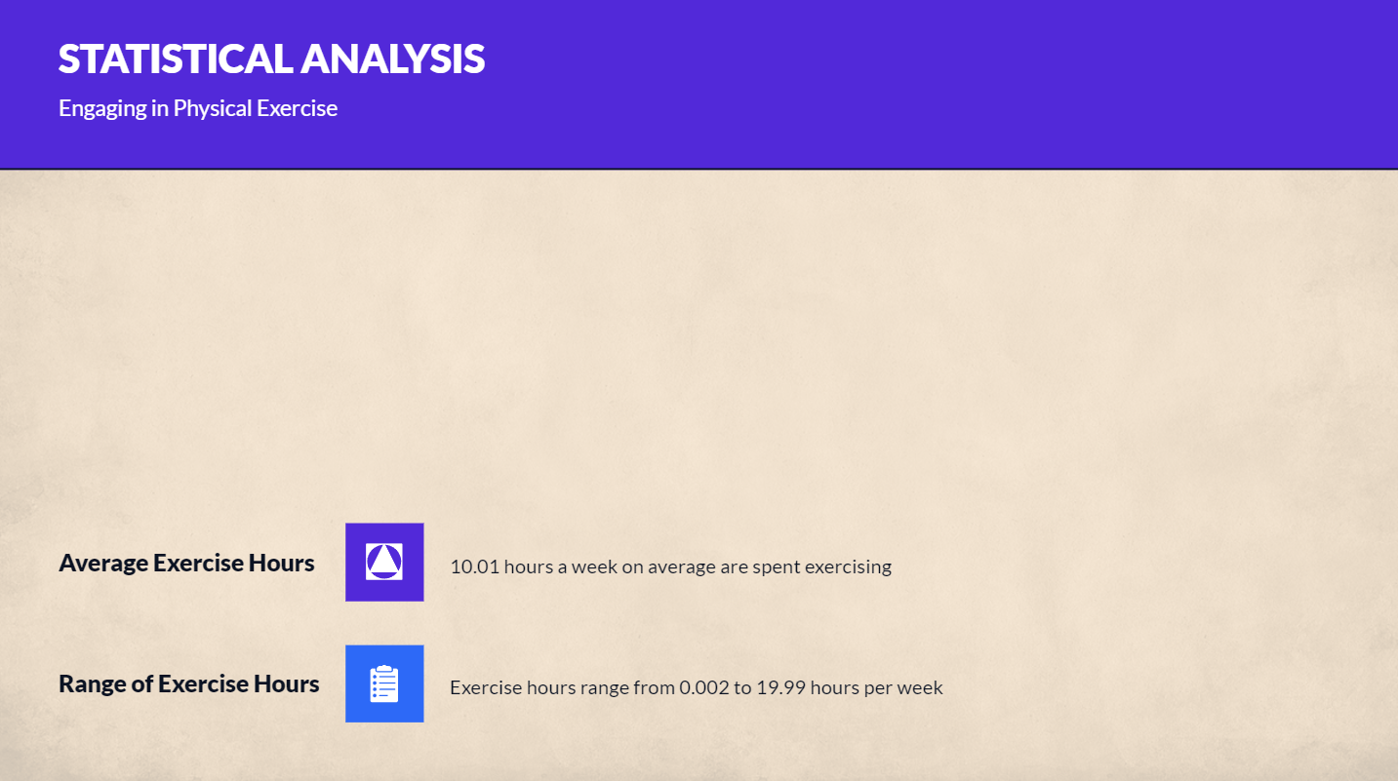

Slide 6
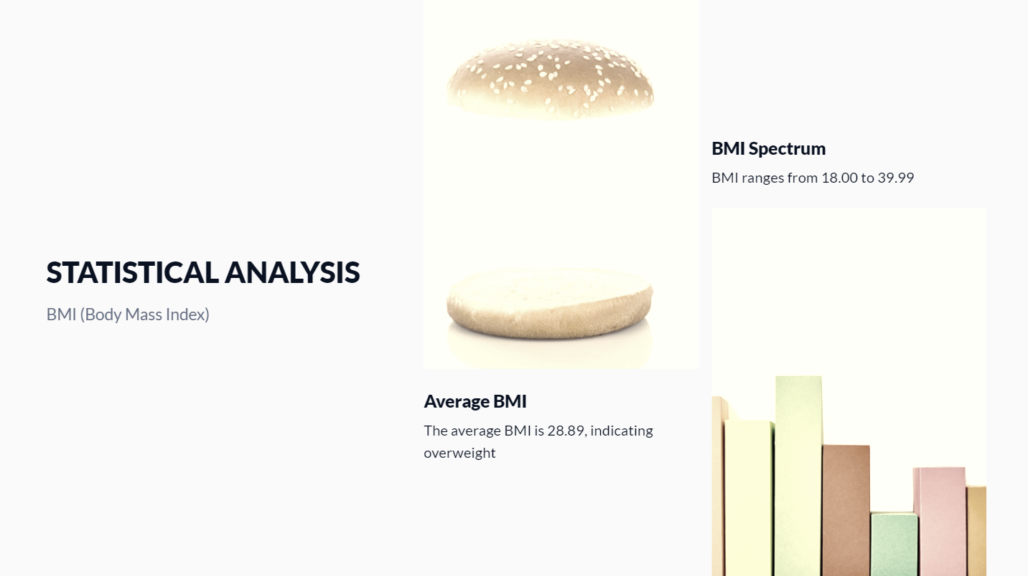

Slide 7
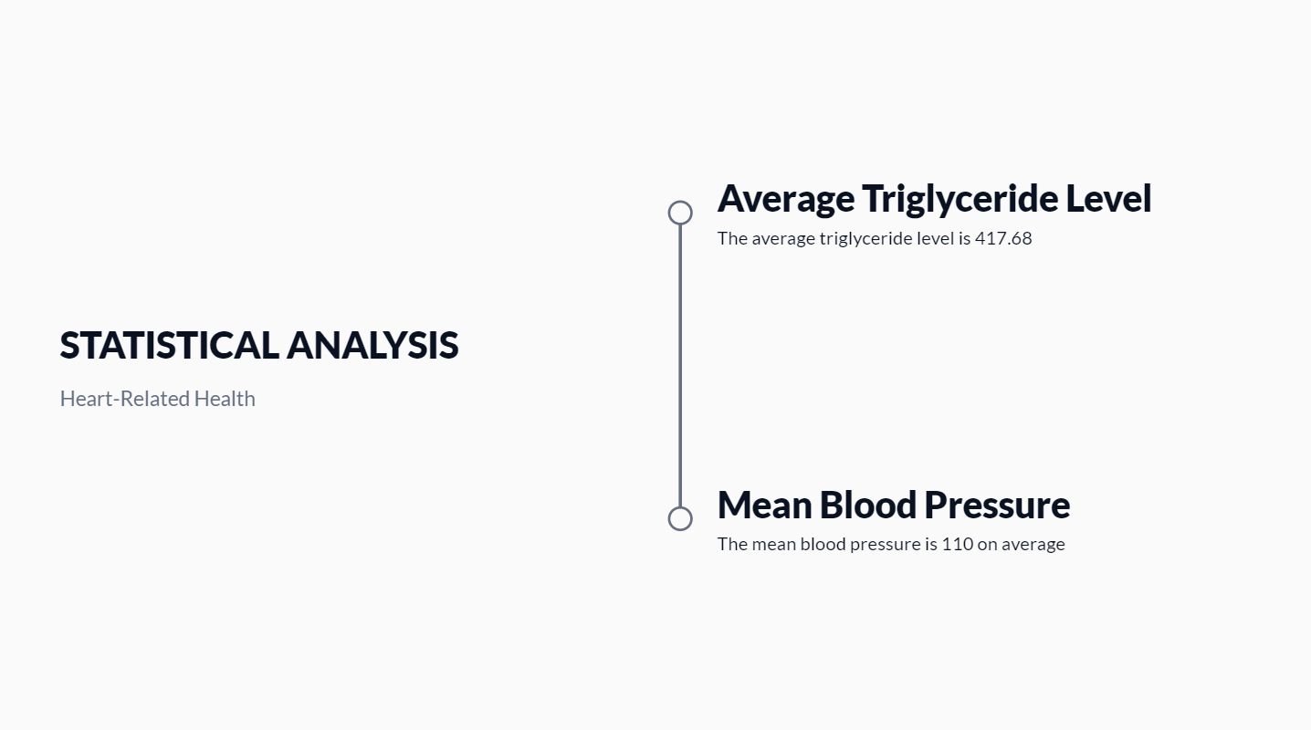

Slide 8
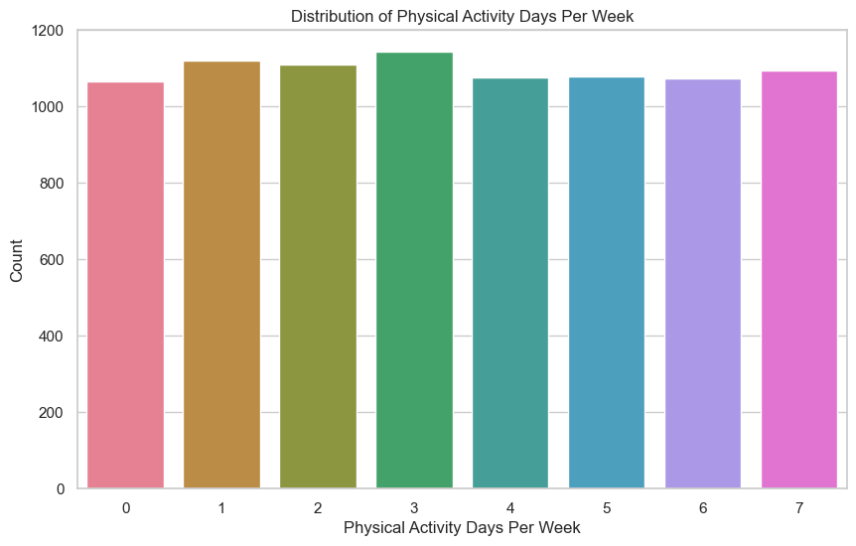
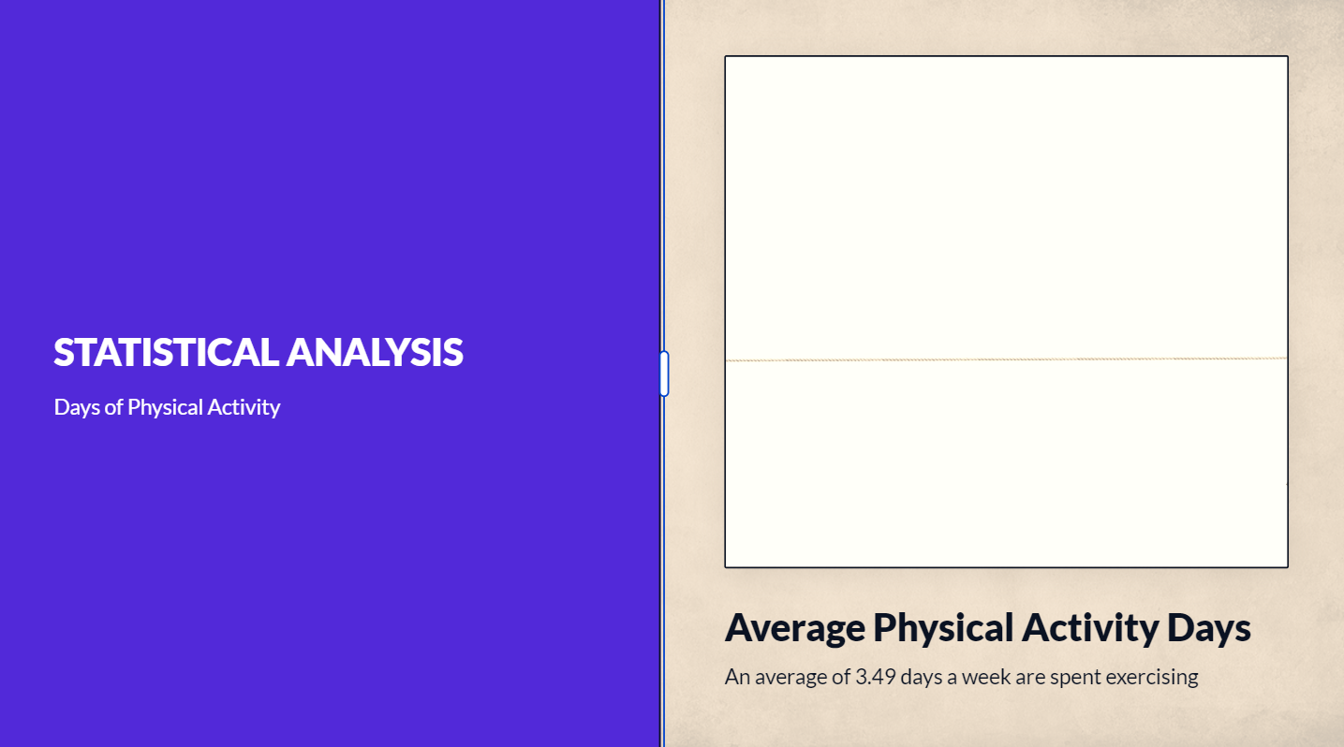

Slide 9
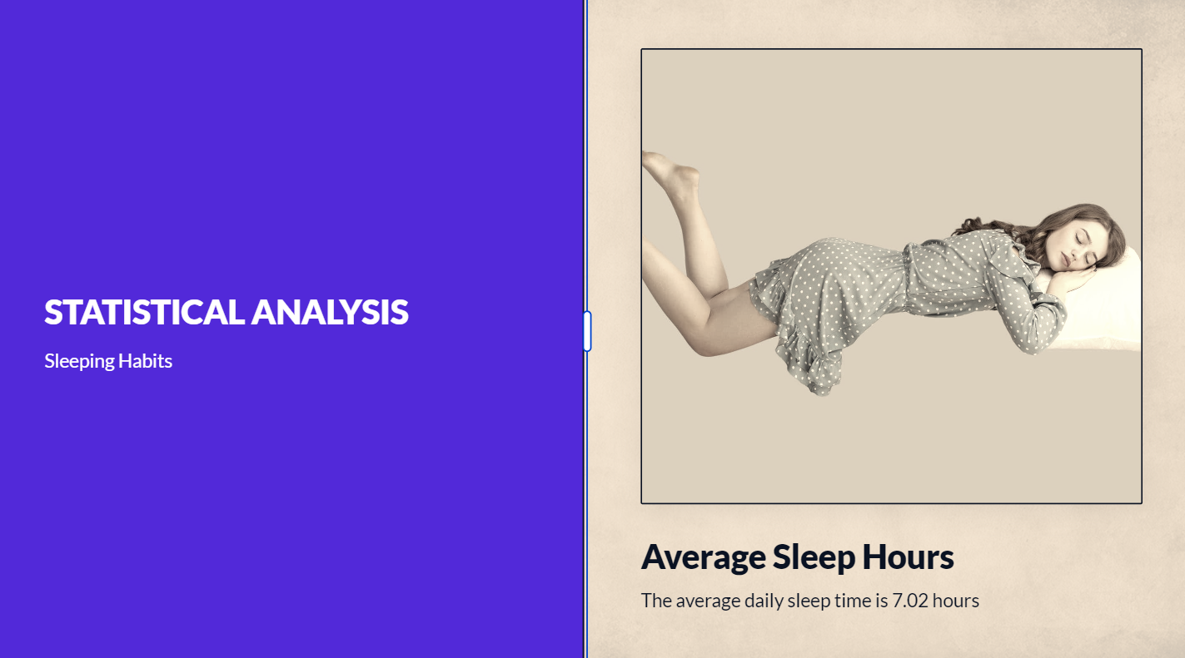

Slide 10
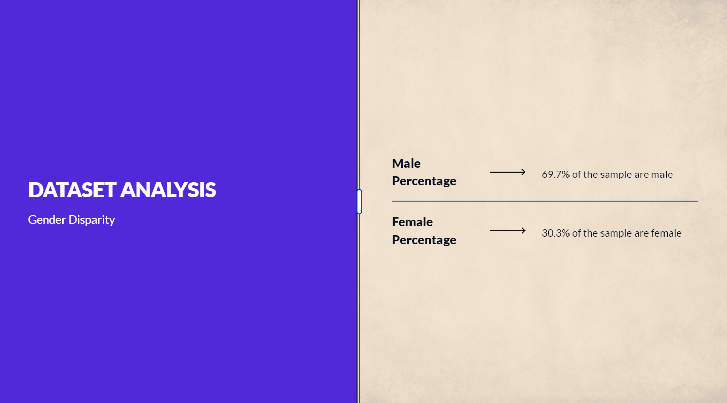

Slide 11
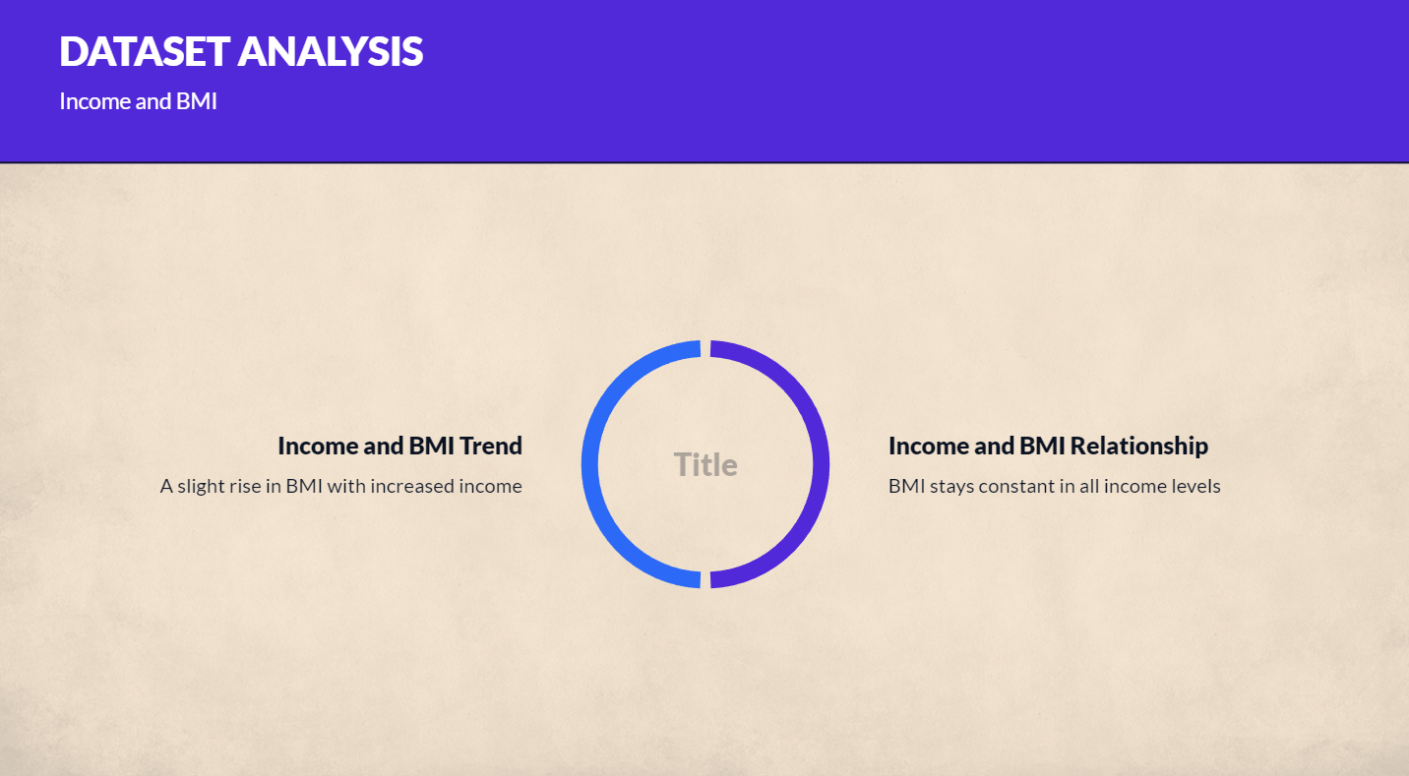
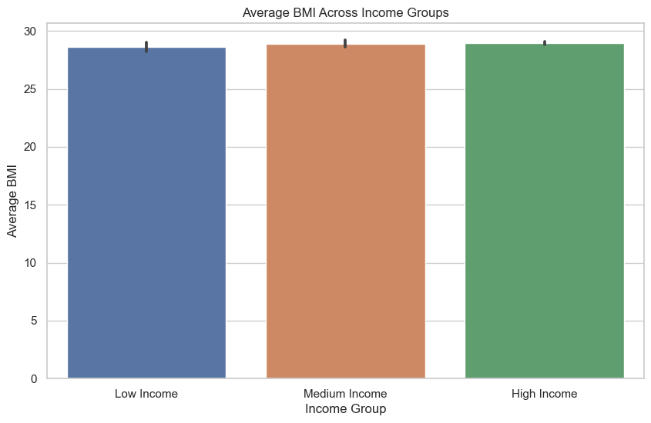

Slide 12
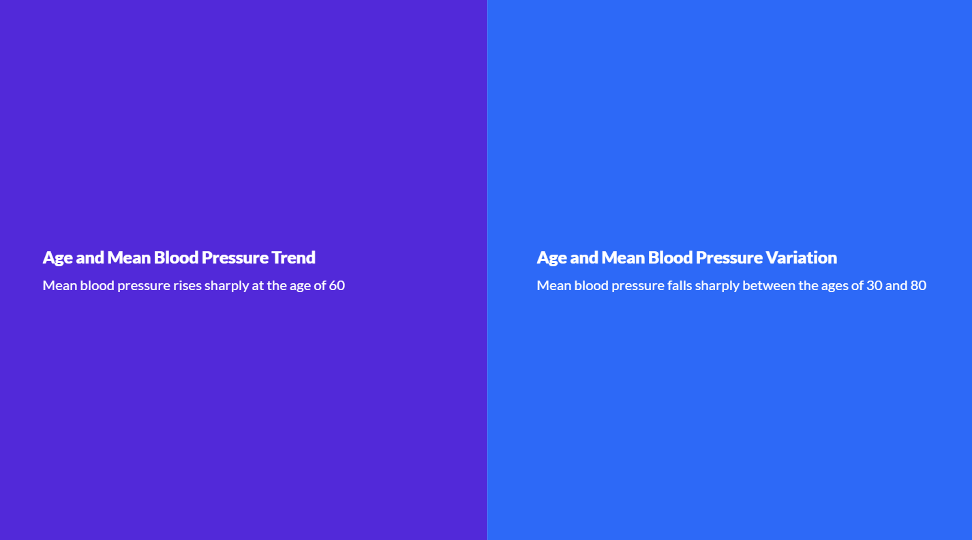
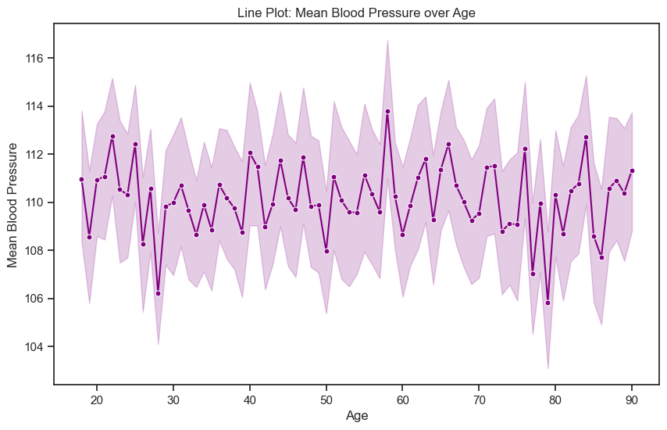

Slide 13
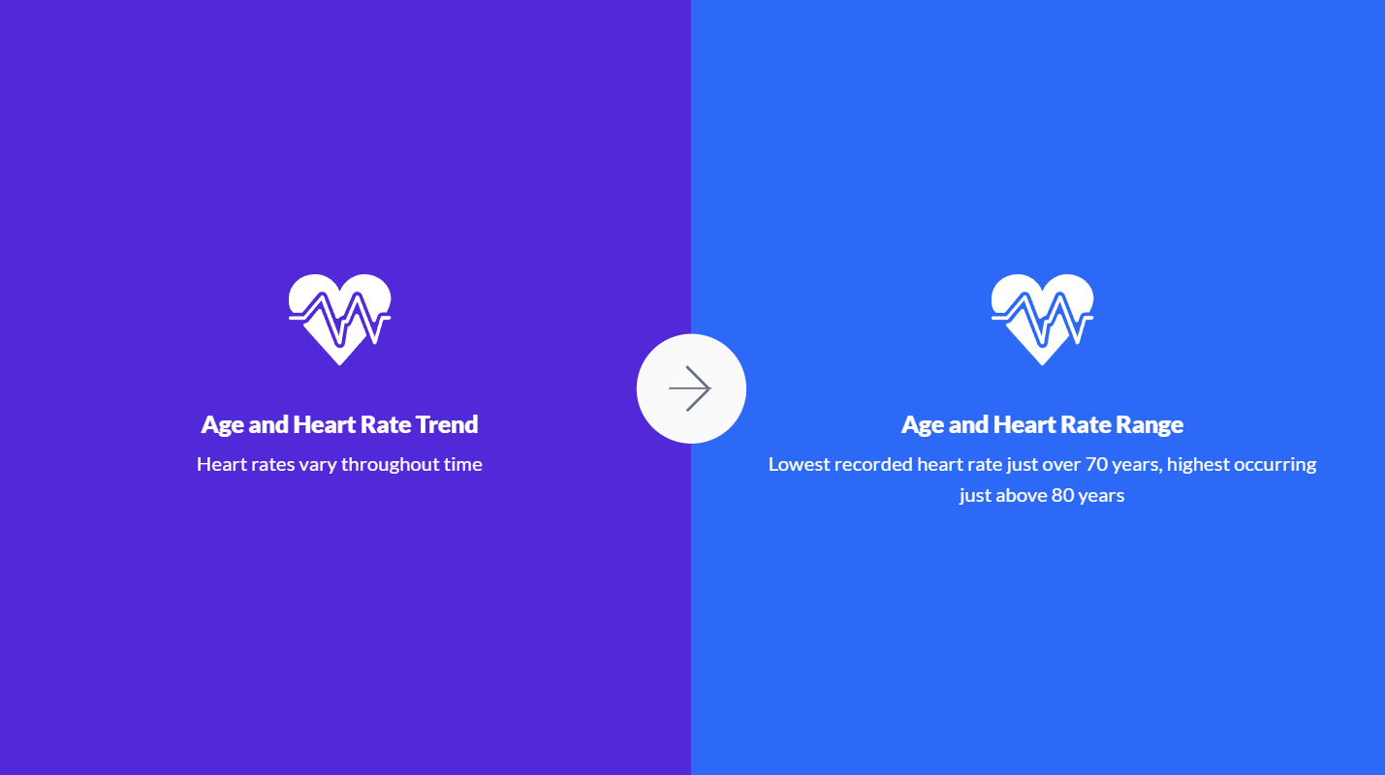
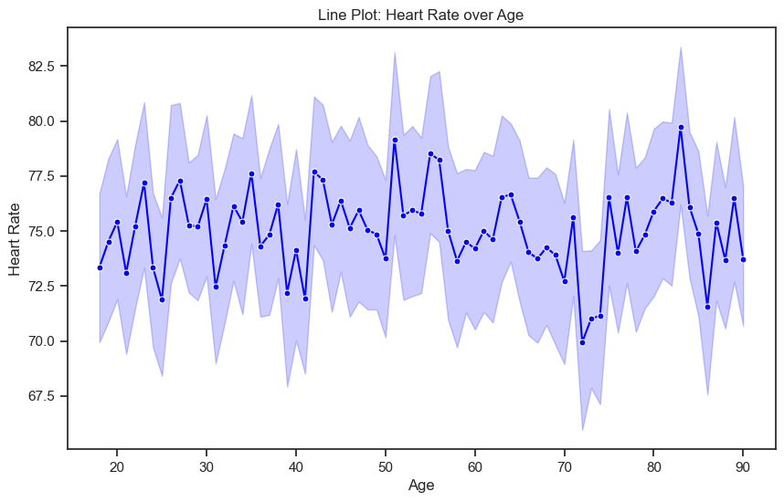

Slide 14
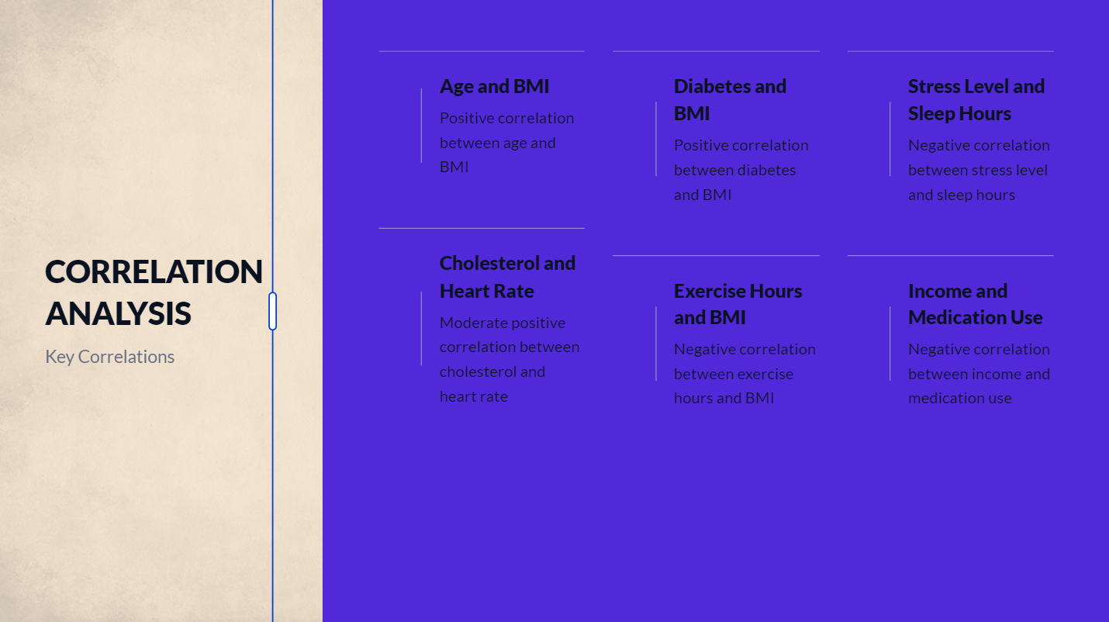

Slide 15
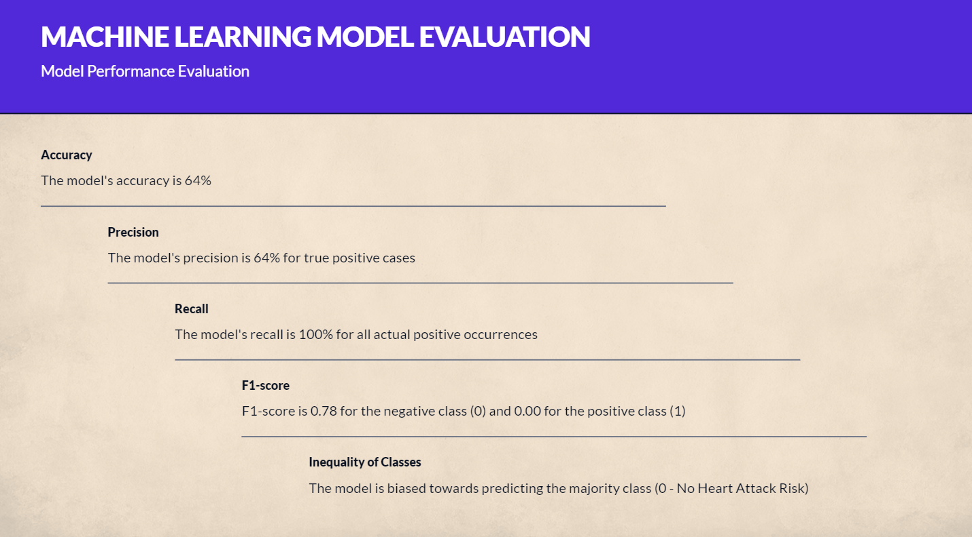

Slide 16
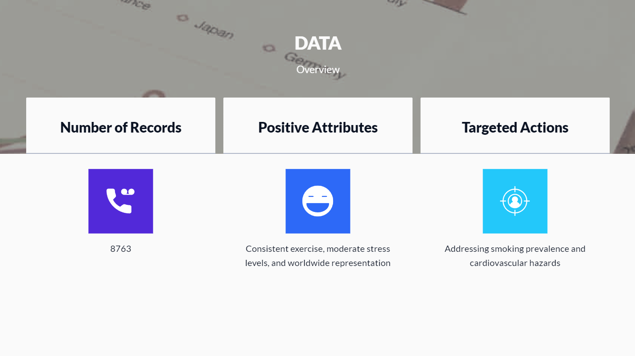

Slide 17

THANK YOU

